Slide 1



Green University of Bangladesh
Department Of Computer Science and Engineering(CSE)
Course Title: Object-Oriented Programming Lab
Course Code: CSE-202 Section: PC-221-DL
Topic: Student Management System
Presented by
Md. Mahim Hossain
ID: 221902082
Presented to
Sagufta Sabah Nakshi
Lecturer, Dept. of CSE
Green University Of Bangladesh
1

Slide 2



Welcome To My Presentation
2

Slide 3
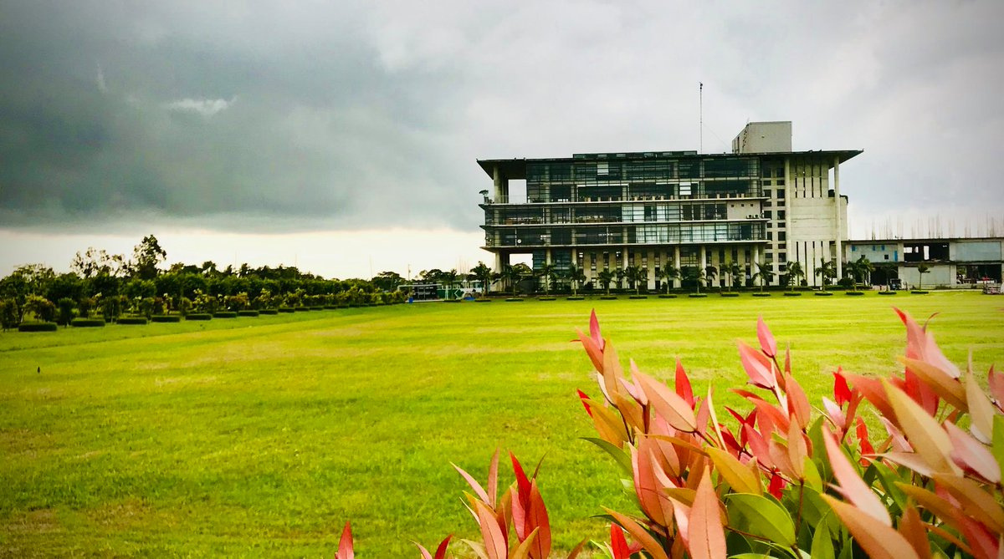
Table Of Content
Introduction
Objective
Concept in Use
Result
Future Updates
Conclusion
3

Slide 4





Introduction
4

Slide 5




Objective
5

Slide 6


Concept in Use
Interface.
Abstraction.
Exception Handling.
Package.
Swing (GUI).
SQL (for the database).
6

Slide 7


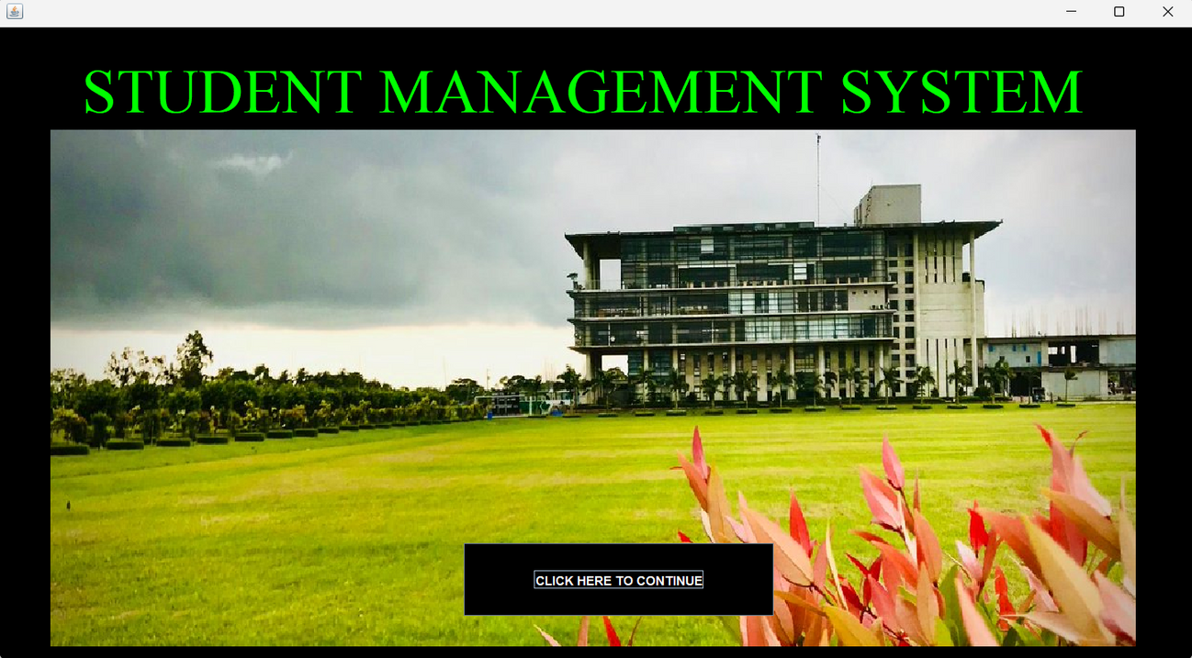

Result
RESULT
First GUI
7

Slide 8


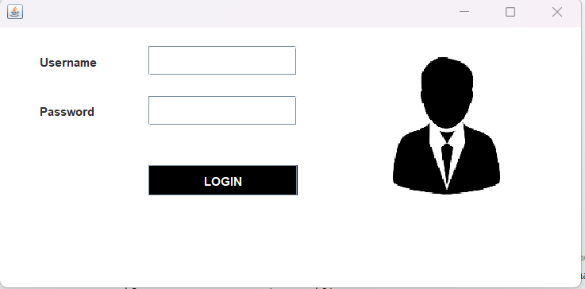
RESULT
Admin Login Panel
8

Slide 9
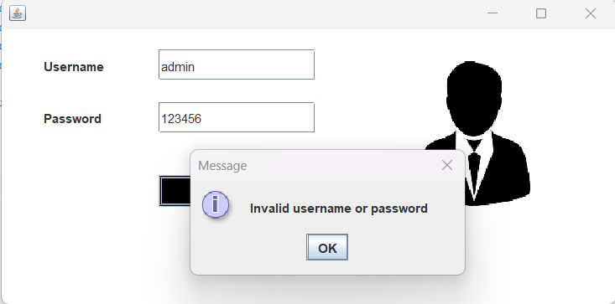

RESULT
Invalid
9

Slide 10


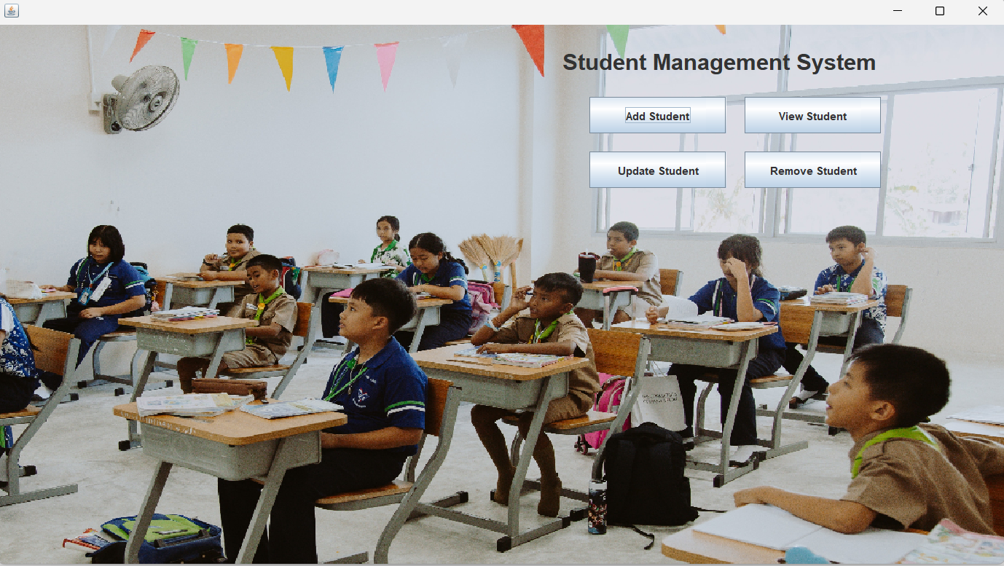
RESULT
Main Dashboard
10

Slide 11
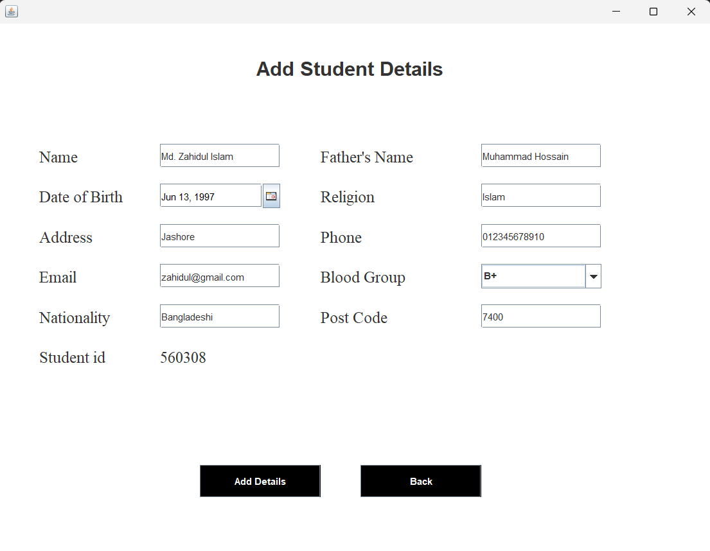



RESULT
Add Student
11

Slide 12


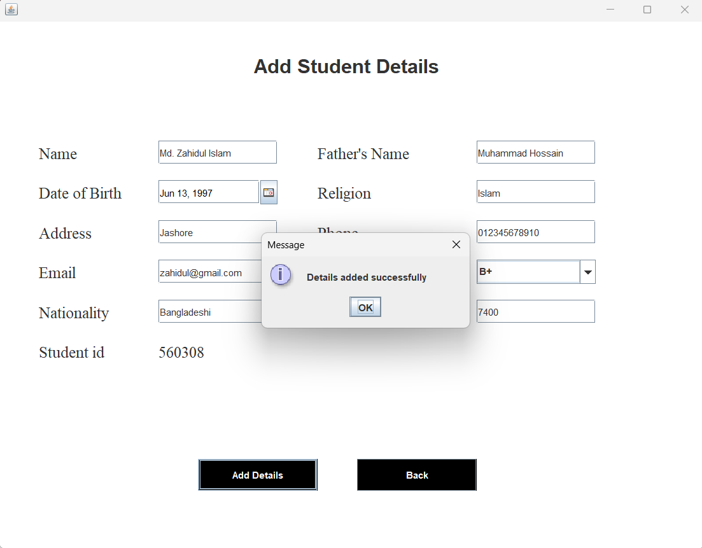

RESULT
Successfully Added
12

Slide 13


RESULT
Main Dashboard
13

Slide 14

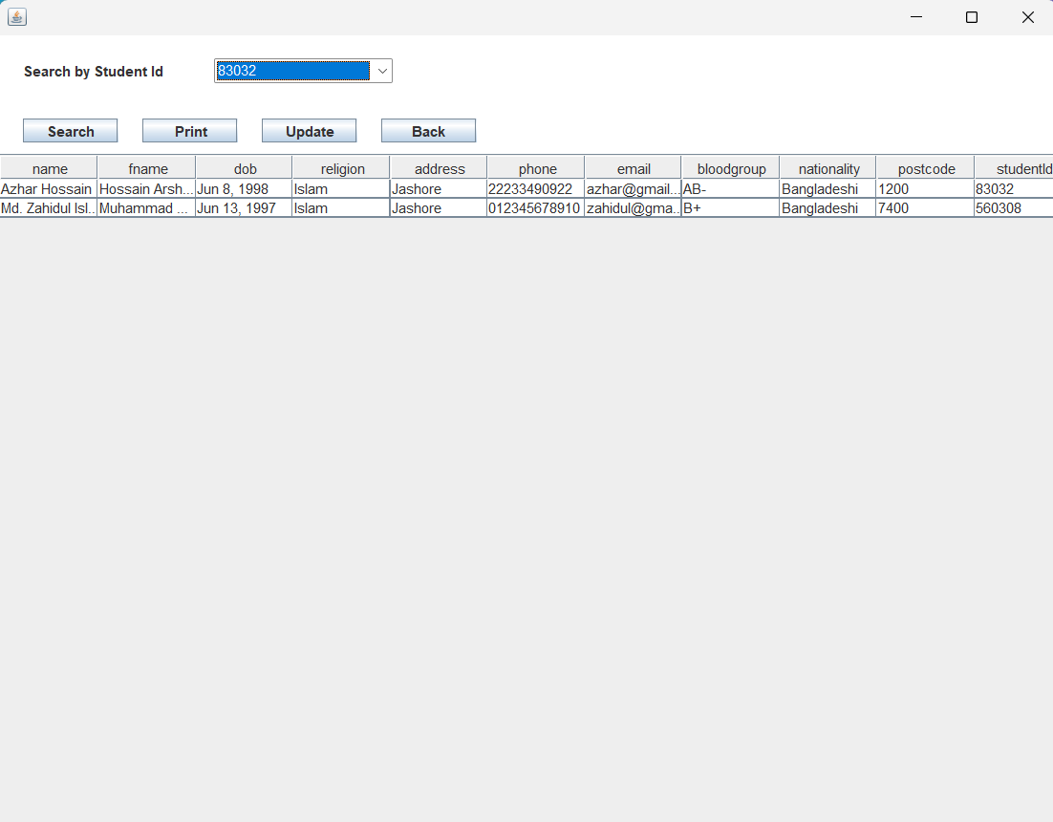
RESULT
View Student
14

Slide 15
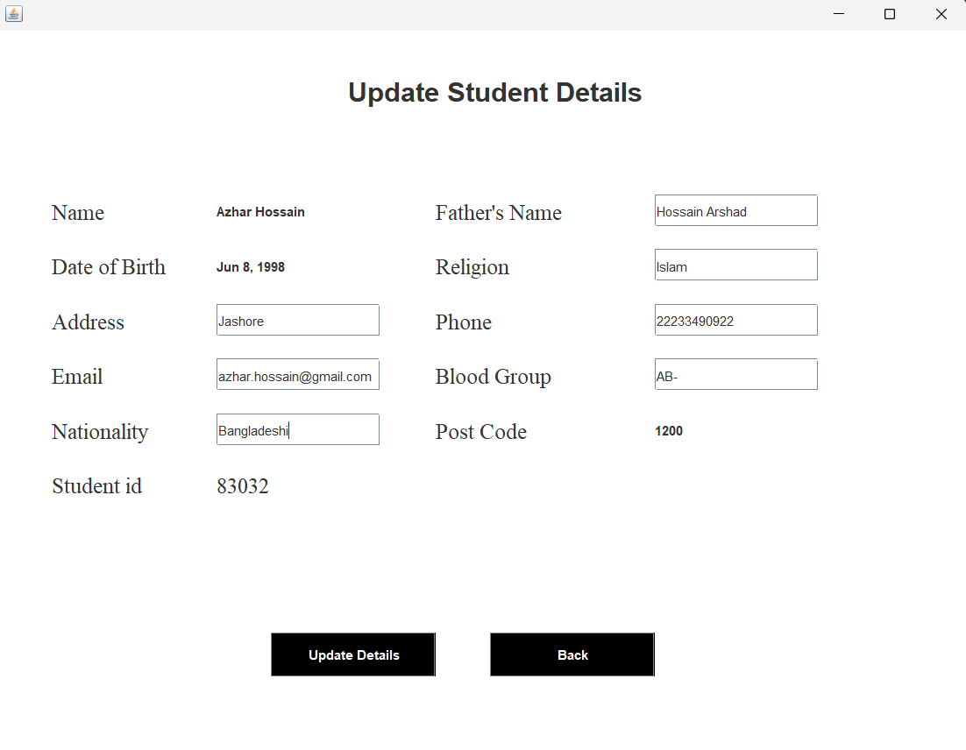
Update Details
15

Slide 16
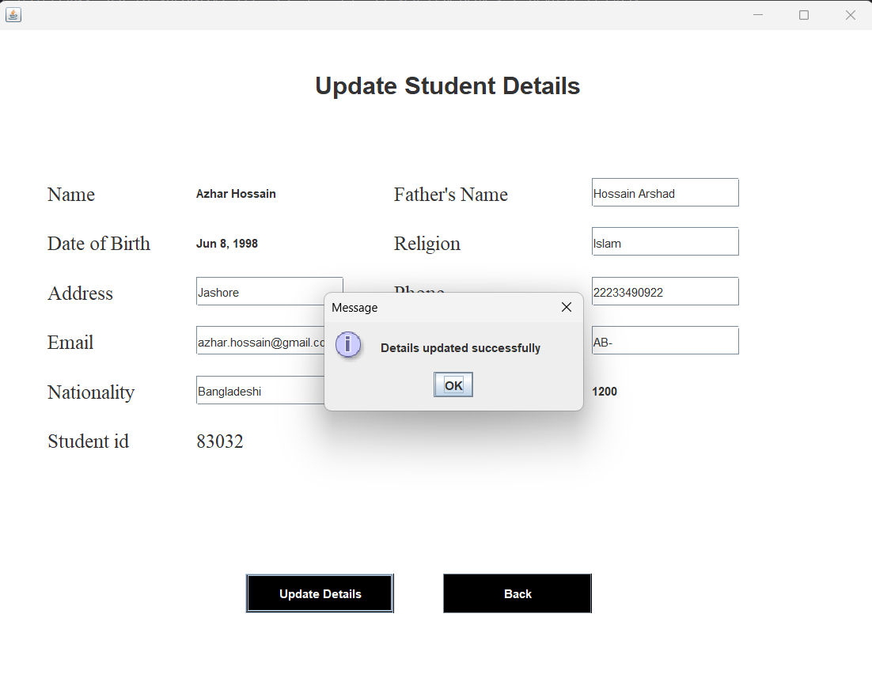
Successfully Updated
16

Slide 17
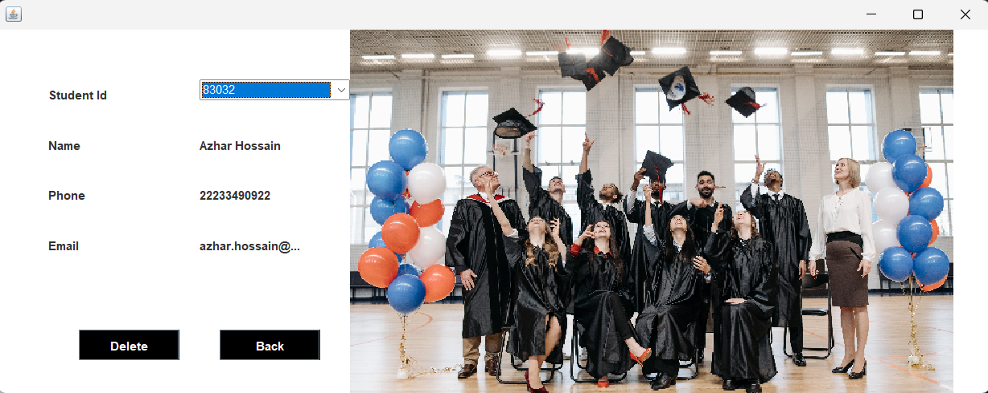
Remove Student
17

Slide 18

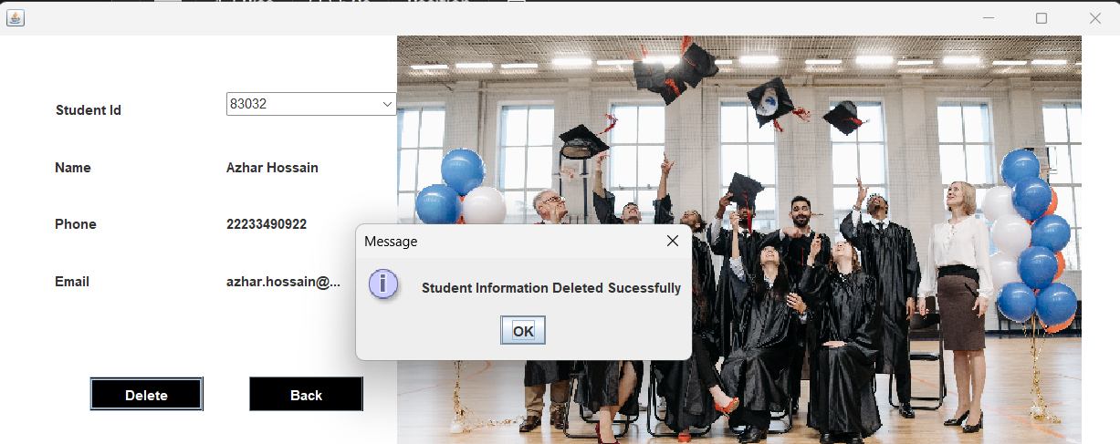
Successfully Removed
18

Slide 19




Future Updates
Better GUI.
Add Courses.
Customization and Integration Options.
Security and Privacy
Better User Experience.
19

Slide 20
Conclusion
20

Slide 21


Any Question?
21

Slide 22
Thank You
22

